Slide 1


A School Registration System for the Gauteng Department of Education
Problem Statements
System Inefficiency (2016)
Learners Remaining at Home (2021 -2023)
Solution Overview
In 2016, the Gauteng Department of Education under former MEC Panyaza Lesufi launched a registration system intended to streamline the application process and enhance transparency. However, it struggled to handle high application volumes and was not user-friendly.
In 2021, 1400 candidates were left uncertain about their education, as they were unable to secure school placements.
Streamlined Registration
Our proposed solution is a comprehensive overhaul of the Gauteng Education Registration System. It incorporates innovative features and adheres to South African policies and frameworks.
In 2023, 8 years later, Over 2000 learners aren't registered by the Gauteng dep of education
- (Mail and Guardian)

Slide 2

Business Model
1
Subscription Model
2
Additional Services
3
Monetization
Its a free system to help the Department of Education.
We will be maintaning the system dynamics of the portal.
Our revenue will be generated through the maintenance.
Technical Implementation
The tech stack we used for this is Python, html, CSS, JavaScript and SQL for the database

Slide 3
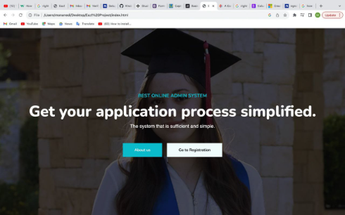
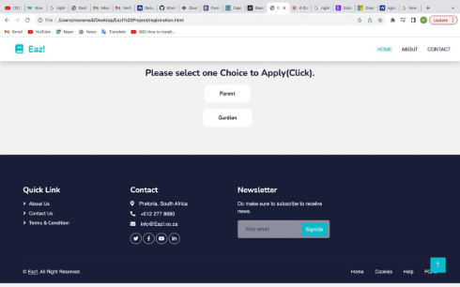
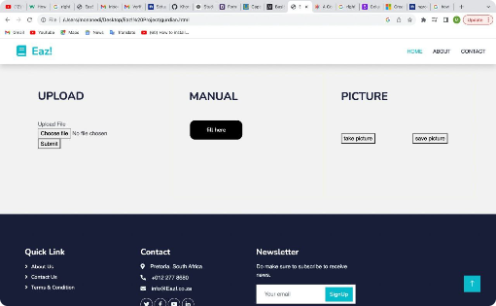
Product

Slide 4
Key Product Features
Online Form
Document Upload
Parents/guardians can easily fill in details manually.
Parents/guardians can easily submit required documents directly through the platform, eliminating the need for physical copies.
Take pictures
USSD Application
Parents/guardians can easily take pictures of your required documents.
Parents/guardians can easily apply with any kind of mobile phone.

Slide 5
Target Market
Public & Private Schools
Education levels
School location
From primary to high schools, our system serves all levels of education.
Strictly for Gauteng Province parents and learners.
Our solution is designed to meet the needs of both public and private educational institutions.

Slide 6
Milestones
1
Development and Testing
Creating and refining the registration system to ensure optimal functionality.
2
Partner Acquisition
Establishing strategic partnerships with Gauteng Department of Education and South African Home Affairs to pilot and implement the product.
3
Nationwide Expansion
Scaling our solution to serve schools across the country and expand market reach after we fix the current Gauteng Province online submission problem.

Slide 7

Call to Action
Join us on our mission to simplify school registration and provide a seamless experience for learners, parents, and administrators. Contact us today for a demo!
Team Members
Monanedi Makhubela: Security Khotso Selading: Product Troubleshooter/ Debugger
Kevin Mokobane: Team Leader / Presenter
Tlotliso Matea: Front-end Developer Bennedict: Back-end Developer

